Slide 1
Purchase Pattern Analysis
Client Project Report
Project ID: CDACL005
Team Code: PTID – CDA – SEP - 25 -741
Batch: 12 – MAY – CDA – BUN – 040 – WDM1130 – BAN
Prepared By: Pruthiraj Samal (pruthirajsamal8802@gmail.com)

Slide 2
Objectives
Week - 1:
✔ Understand the structure and contents of the dataset
✔ Perform Exploratory Data Analysis (EDA) to gain insights
✔ Identify missing values, outliers, and inconsistencies
✔ Generate initial visualizations to understand trends and patterns

Slide 3
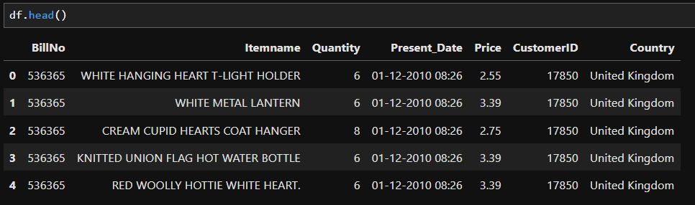
Dataset Overview
Dataset Details:
- Number of rows: 522064
- Number of columns: 7
Key Columns: BillNo, Itemname, Quantity, Present Date, Price, CustomerID, Country

Slide 4
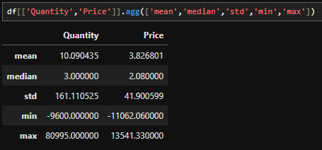
Summary Statistics
Summary Statistics for key numerical columns:
- Quantity:
• Mean: 10.090435
• Median: 3.000000
• Std: 161.110525
• Max: -9600.000000
• Min: 80995.000000
- Price:
• Mean: 3.826801
• Median: 2.080000
• Std: 41.900599
• Max: -11062.060000
• Min: 13541.330000

Slide 5
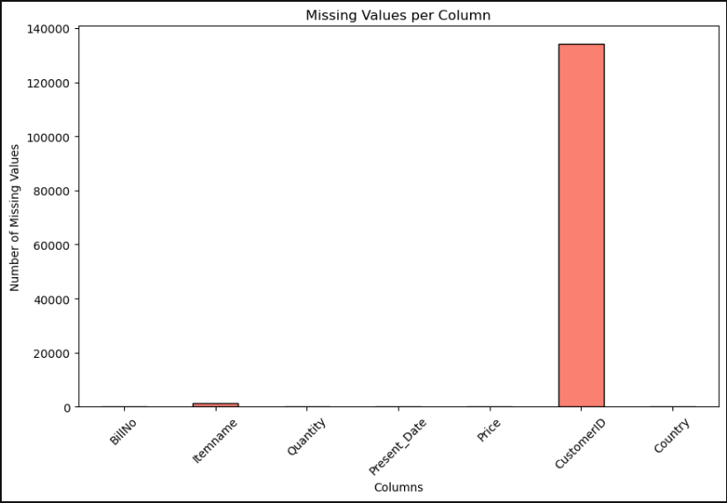
Missing Values
Missing Value Analysis:
- CustomerID column has missing values 134041 (~25.7% of records)
- Itemname column has missing values 1455 (~ 0.28% of records)
- All other columns are complete
- Missing values can affect association analysis

Slide 6
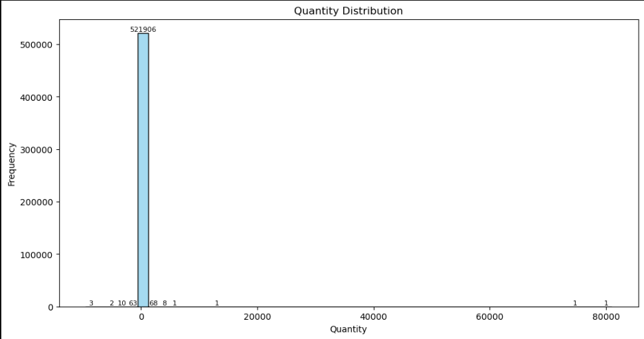
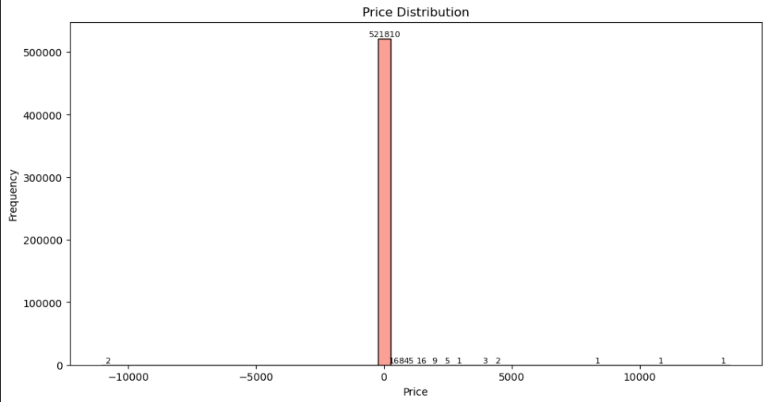
Data Distributions
Quantity Distribution:
Most transactions involve 1–5 items.
Some extreme values exist, indicating bulk purchases.
Negative quantities are present, representing returns or cancellations.
Price Distribution:
Majority of items are low-priced (< ₹500).
A few very high-priced items exist, which are outliers.
Price distribution is right-skewed, with a long tail toward higher prices.

Slide 7
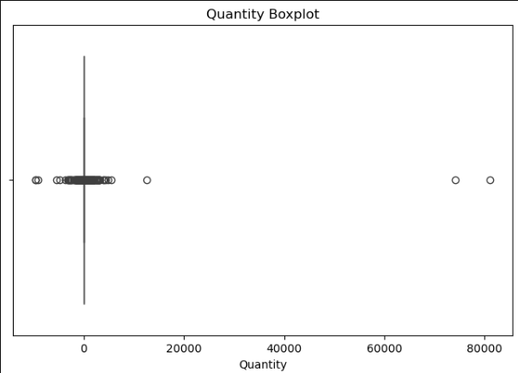
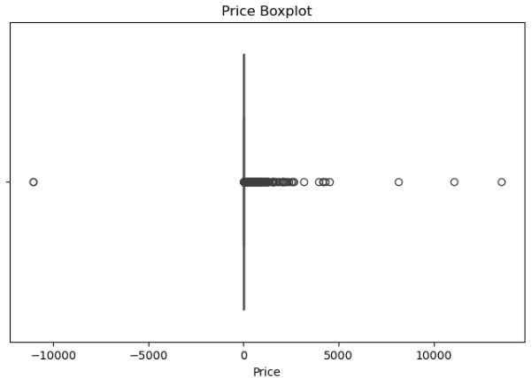
Outliers
Quantity Outliers:
Some transactions have very high quantities, indicating bulk purchases.
Negative quantities represent returns or cancellations.
Price Outliers:
Most items are low-priced (< ₹500).
Few items have very high prices, showing premium products or rare cases.

Slide 8
Key Findings
Dataset contains 522,064 records and 7 columns.
Missing values exist in:
Itemname → 1,455 records (~0.28%)
CustomerID → 134,041 records (~25.7%)
Quantity distribution: Most transactions involve 1–5 items; some very high quantities exist; negative quantities indicate returns.
Price distribution: Majority of items priced below ₹500; a few high-priced outliers exist; distribution is right-skewed.
Outliers: High Quantity and Price values may affect analysis

Slide 9
THANK YOU

